Slide 1
Operational Amplifier, Its types and Instrumentation Amplifier
Presented By: C G
Prabin Chaudhary
Prajwal Chaudhary
Sagar Chaudhary
Sandesh Chaudhary
NAST, Dhangadhi

Slide 2
Outlines
1.1 Introduction
1.2 Inverting Operational Amplifier
1.3 Non Inverting Operational Amplifier
1.4 Types of Operational Amplifier
1.4.1 Adder / Summer Operational Amplifier
1.4.2 Subtractor
1.4.3 Differentiator
1.4.4 Integrator
1.5 Instrumentational Amplifier

Slide 3
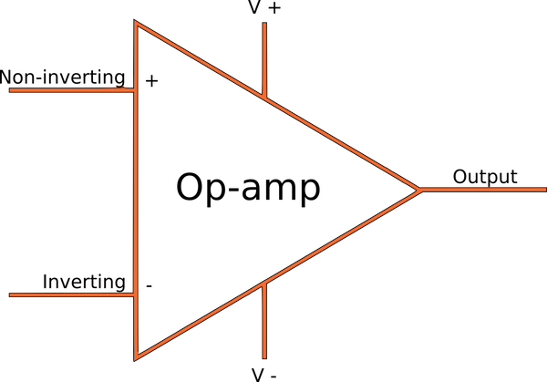
Introduction
Operational Amplifier, also called as an Op-Amp, is an integrated circuit, which can be used to perform various linear, non-linear, and mathematical operations.
It consists of three terminals: two high-impedance inputs and a low-impedance output port. A minus sign denotes the inverting input (-), while the non-inverting input is denoted by a positive sign (+).

Slide 4
Types Of Operational Amplifier
Depending upon the input terminal, the operational amplifier is classified on two types:
Inverting Operational Amplifier
Non- Inverting Operational Amplifier

Slide 5
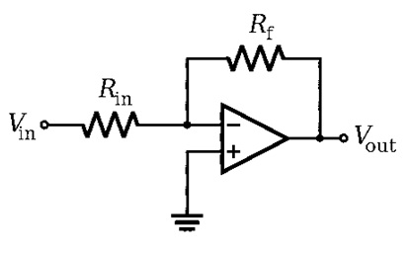
inverting operational amplifier
When the input is provided only at the inverting terminal (-), keeping the non-inverting terminal (+) grounded. This type of Op-Amp is known as Inverting Operational Amplifier.

Slide 6
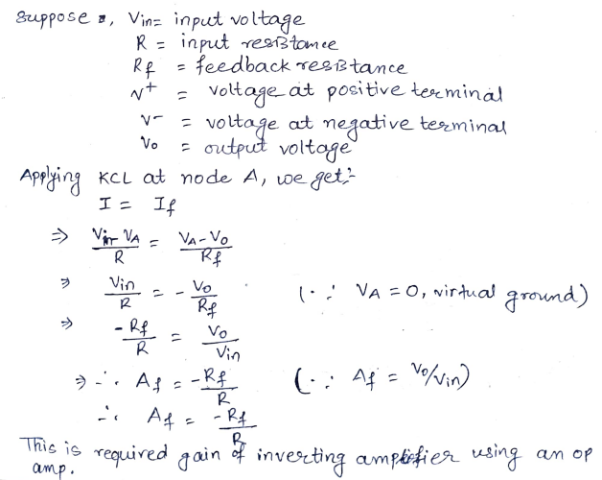

Slide 7
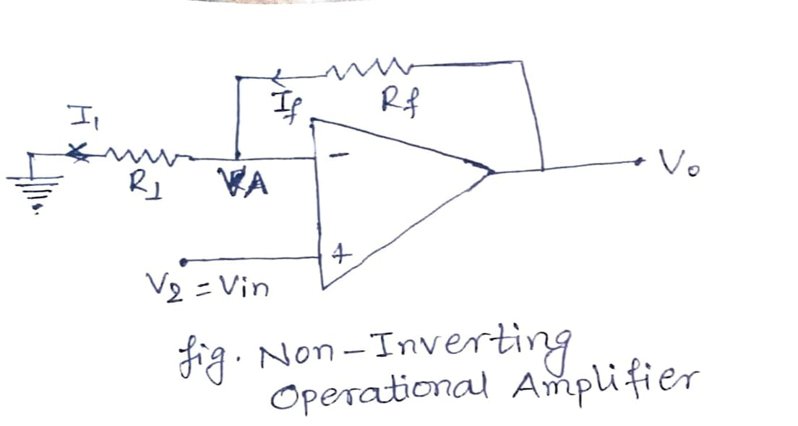
Non inverting operational amplifier
When the input is provided only at the non-inverting terminal (+), keeping the inverting terminal (-) grounded. This type of Op-Amp is known as Non- Inverting Operational Amplifier.

Slide 8
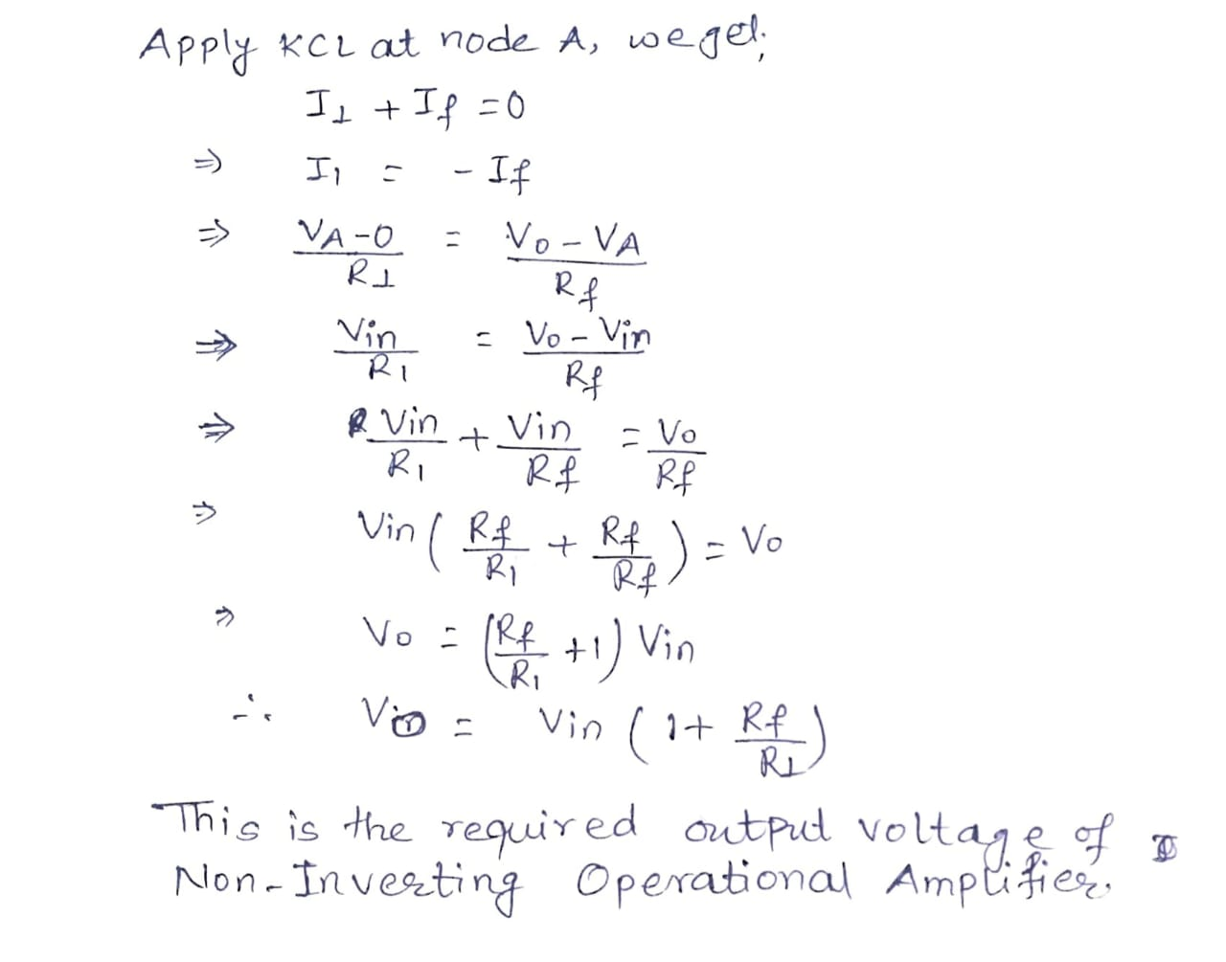

Slide 9
Types of Operational Amplifier1
Depending upon the operation, the operational amplifier are classified as:
1. Adder / Summer Operational Amplifier
2. Subtractor Operational Amplifier
3. Differential Amplifier
4. Integrator Amplifier

Slide 10
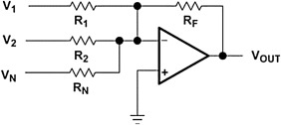
Adder / Summer Operational Amplifier
The main function of adder / summer amplifier is to provide an output which is proportional to the algebraic sum of two or more input voltages each multiplied by a constant gain factor.
Fig. Adder/ Summer Op-Amp

Slide 11
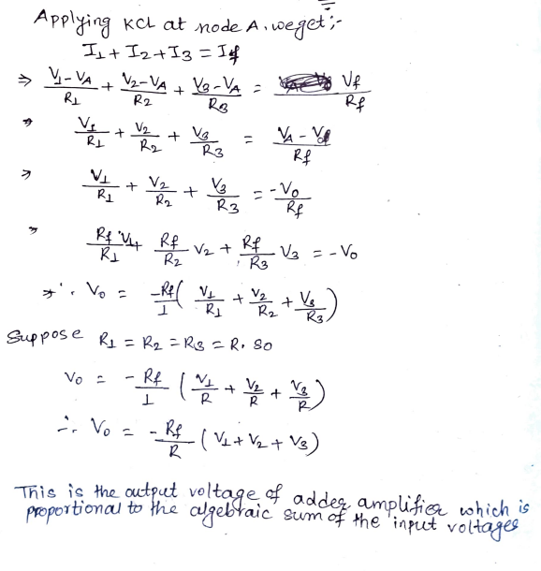

Slide 12
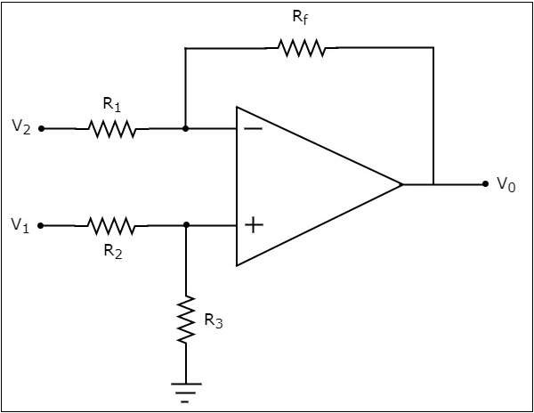
Subtractor/Difference Operational Amplifier
The main function of subtractor amplifier is to provide an output which is proportional to the difference of two input signals.

Slide 13
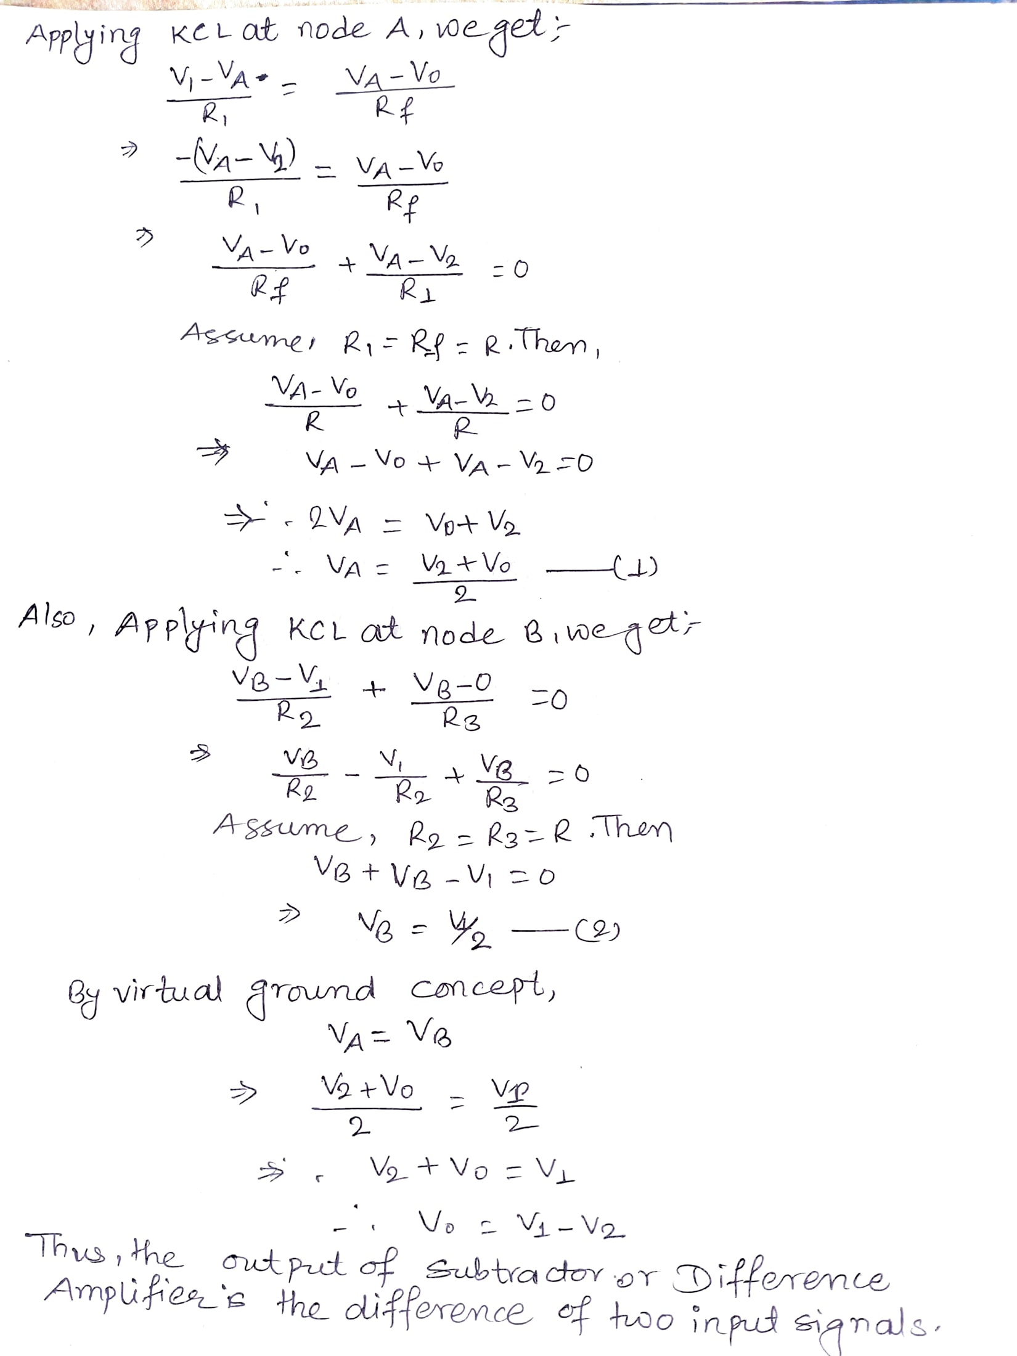

Slide 14
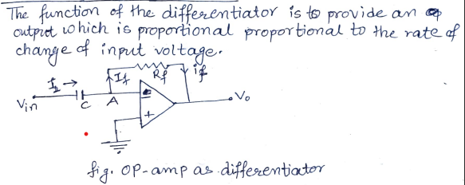
Differentiator Operational Amplifier

Slide 15
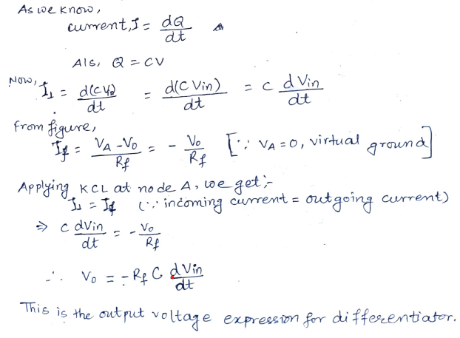

Slide 16
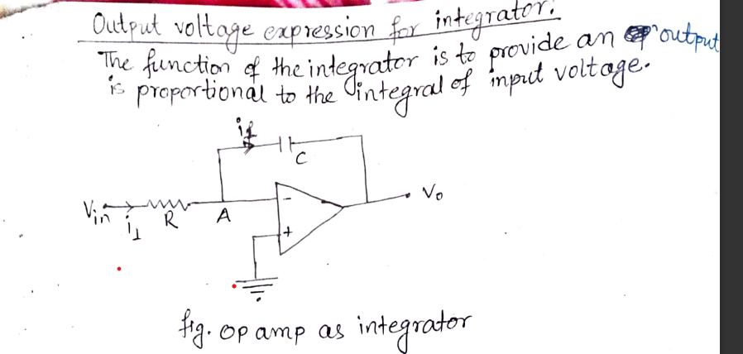
Integrator Operational Amplifier

Slide 17
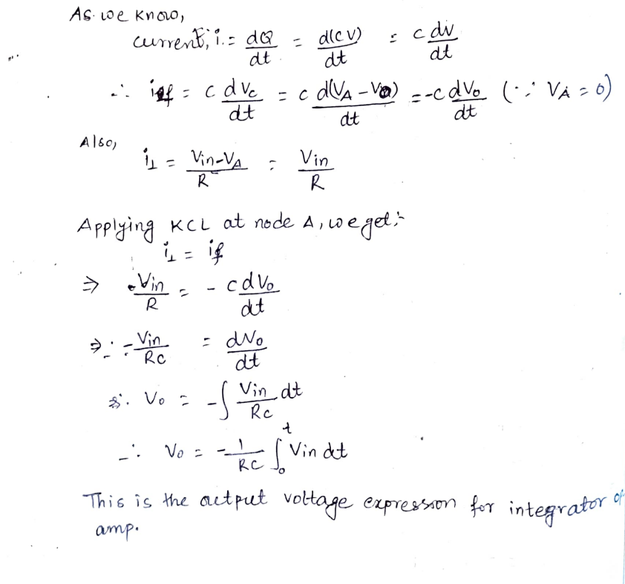

Slide 18
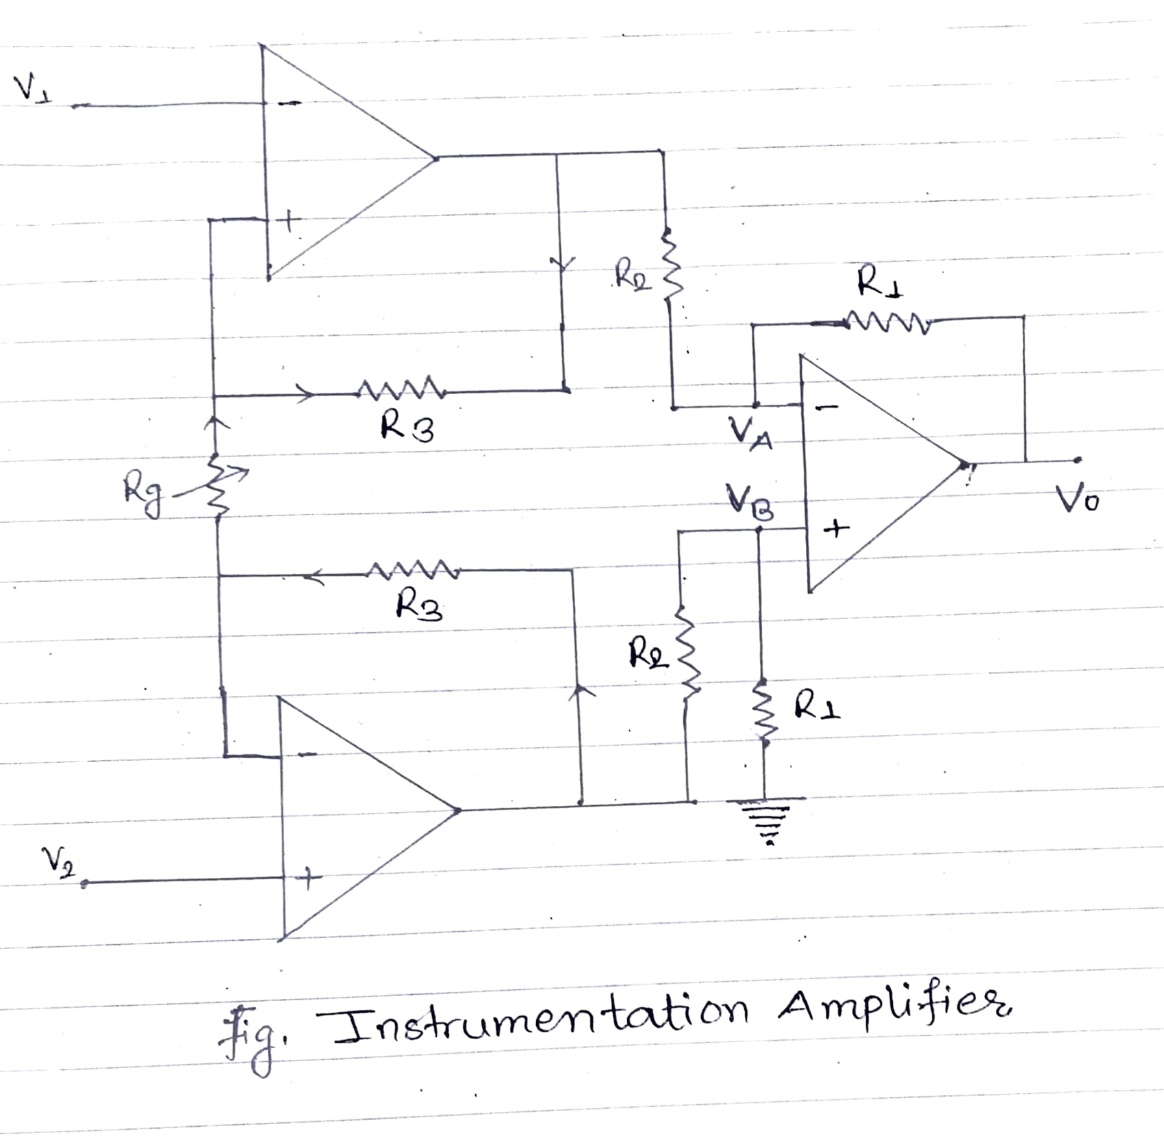
Instrumentation Amplifier
Instrumentation amplifier is a type of amplifier that is used to amplify the difference between two input signals while rejecting any common-mode signals.
It has a high gain, high common-mode rejection ratio (CMRR), low noise, and high input impedance.
It is used in a wide variety of applications, such as biomedical instrumentation, industrial instrumentation, test and measurement equipment, data acquisition systems, and analog signal processing.

Slide 19
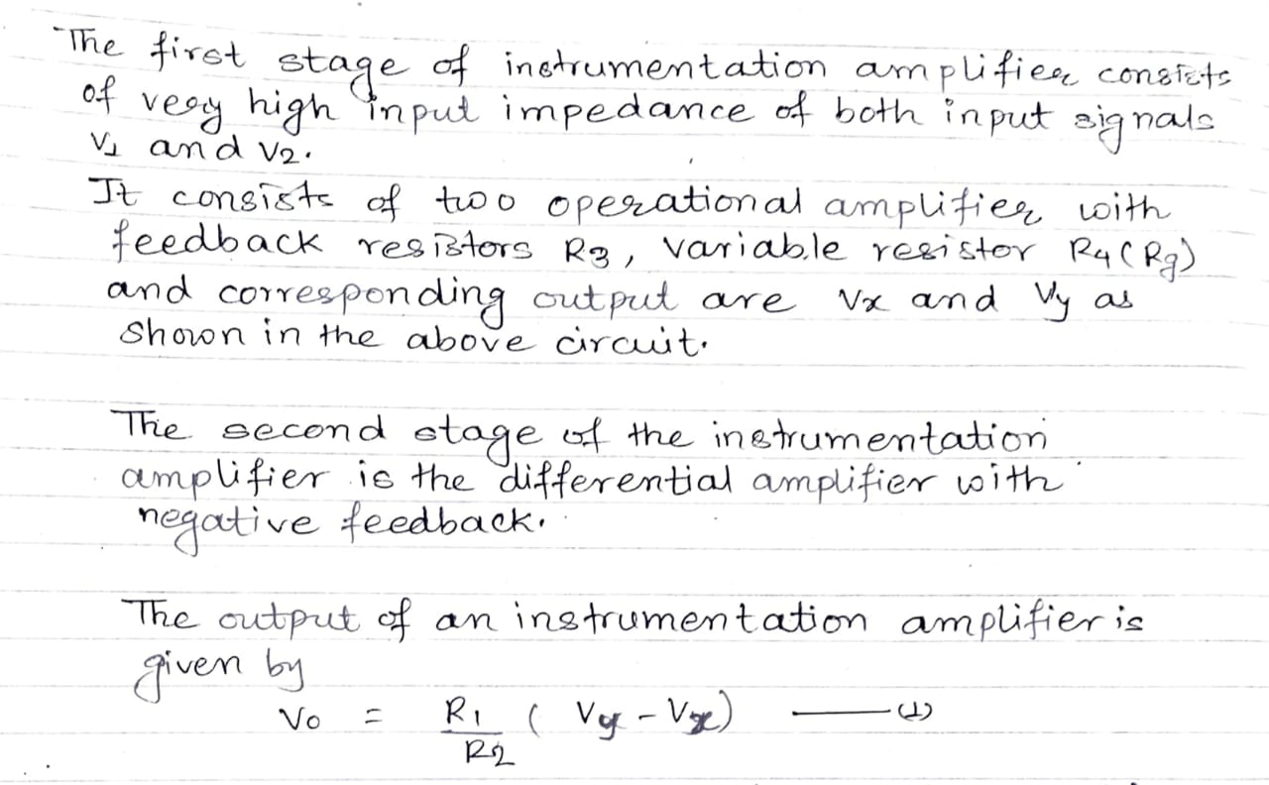

Slide 20
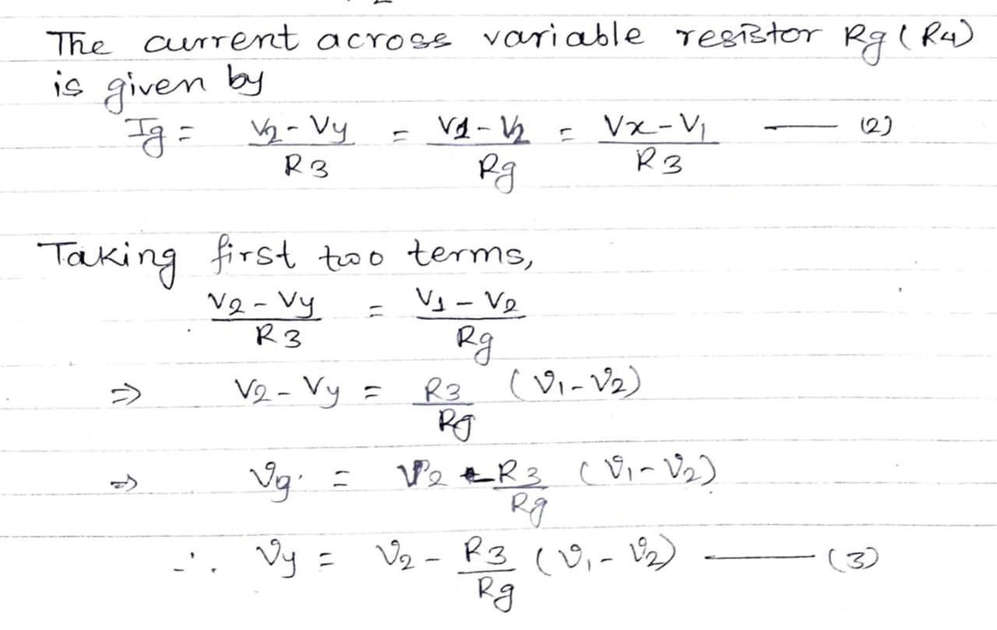

Slide 21
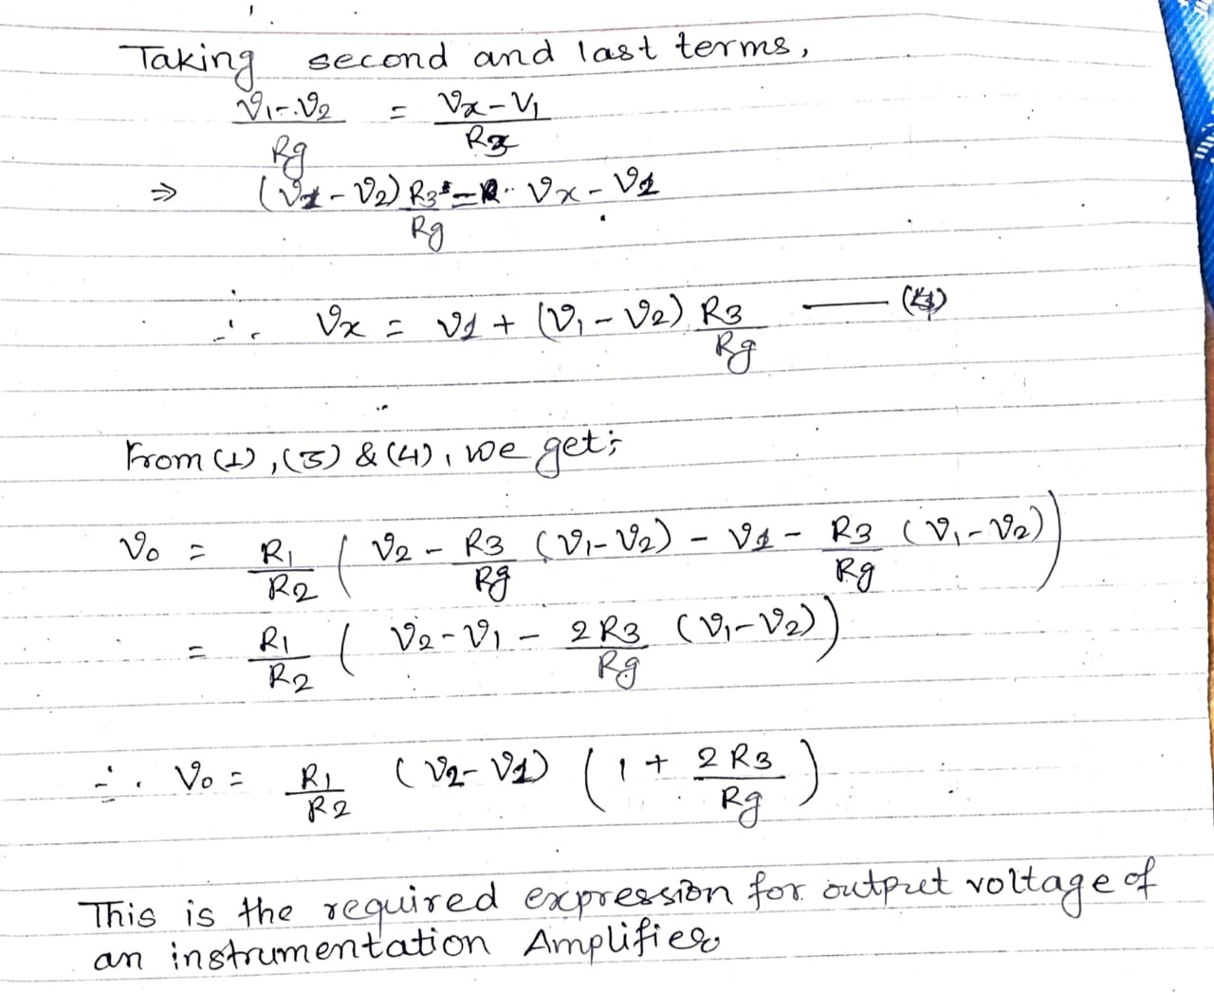

Slide 22
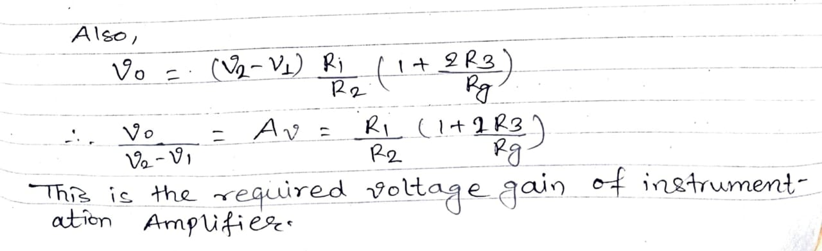

Slide 23


